Slide 1

Team Prasad-Feldgarden:
Arjun Prasad, Team co-Lead
Michael Feldgarden, Team co-Lead
Adrien Assie, Tech Lead
Ana Ramos, Writer
EB Dickinson
Chienchi Lo
Erin Young

Slide 2
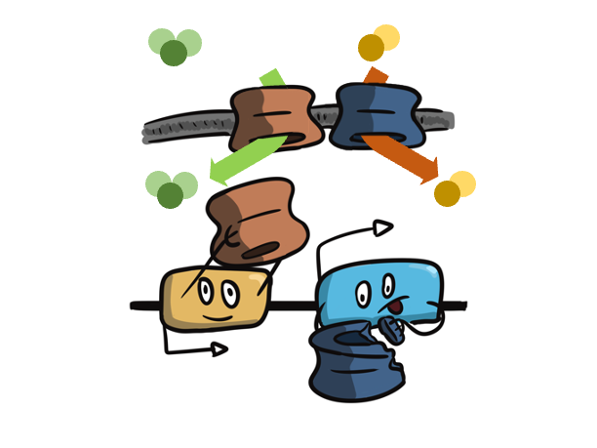
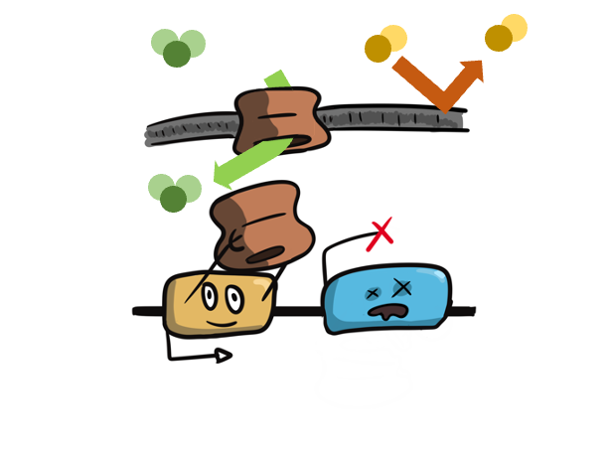
Breaking a gene can lead to resistance
Genes that are the target of antibiotics
K. pneumoniae CirA - siderophore receptor used to import iron and the antibiotic cefiderocol
Porins that let antibiotics into the cell
K. pneumoniae OmpK35/K36
Loss-of-function mutations confer resistance to carbapenems and other beta-lactams
Regulatory genes
P. aeruginosa NalD - efflux system regulator
P. aeruginosa AmpD - beta-lactamase gene regulator
confer resistance to carbapenems and other beta-lactams
A. baumannii AdeS - efflux pump regulator

Slide 3
Project Overview
Existing AMR gene detection software screens for known mutations
Develop a tool and database to identify loss-of-function mutations in genes known to confer resistance when disrupted
Identify lesions that should ‘break’ the gene:
Frameshifts
Internal stops (nonsense mutations)
Run the tool(s) on assemblies in NDARO to characterize the presence of novel loss-of-function mutations in those genes for three taxa
Acinetobacter baumannii
Klebsiella pneumoniae
Pseudomonas aeruginosa

Slide 4
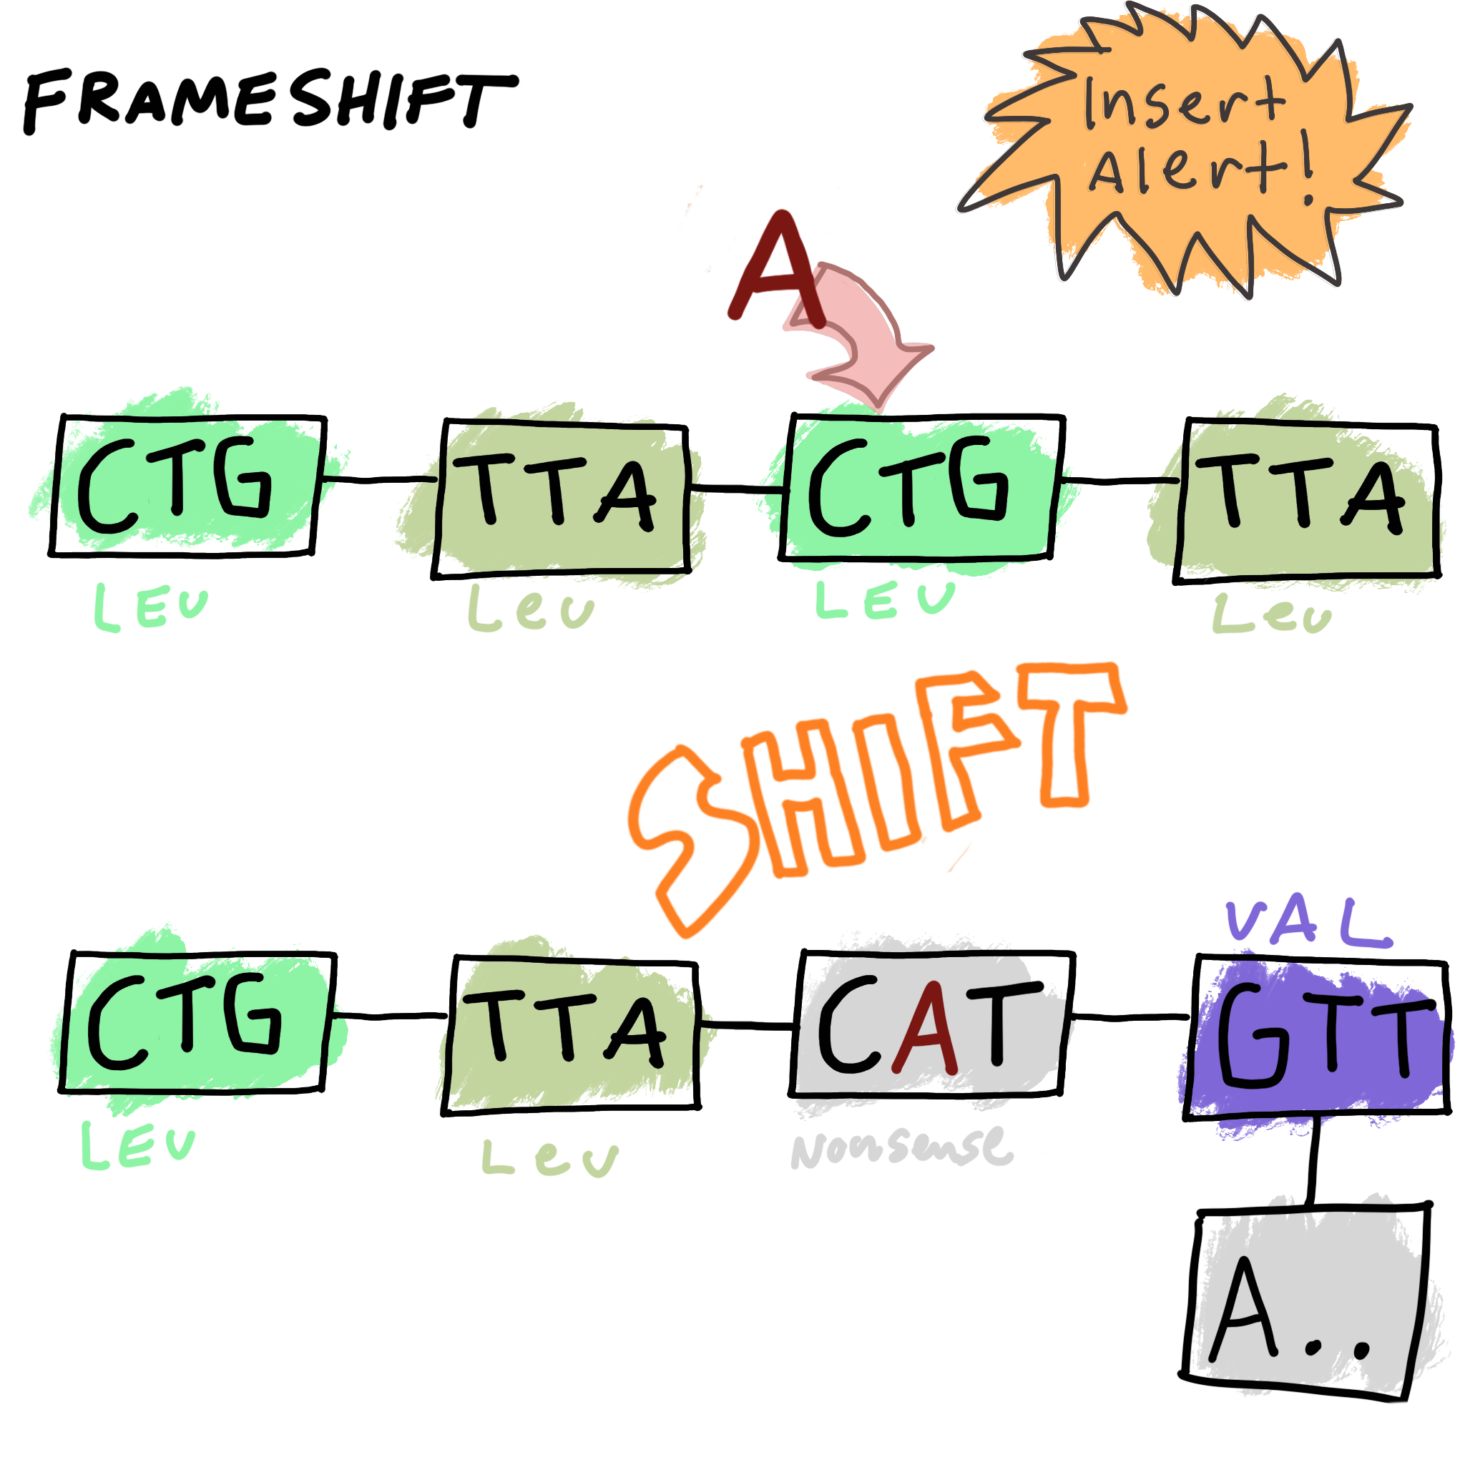
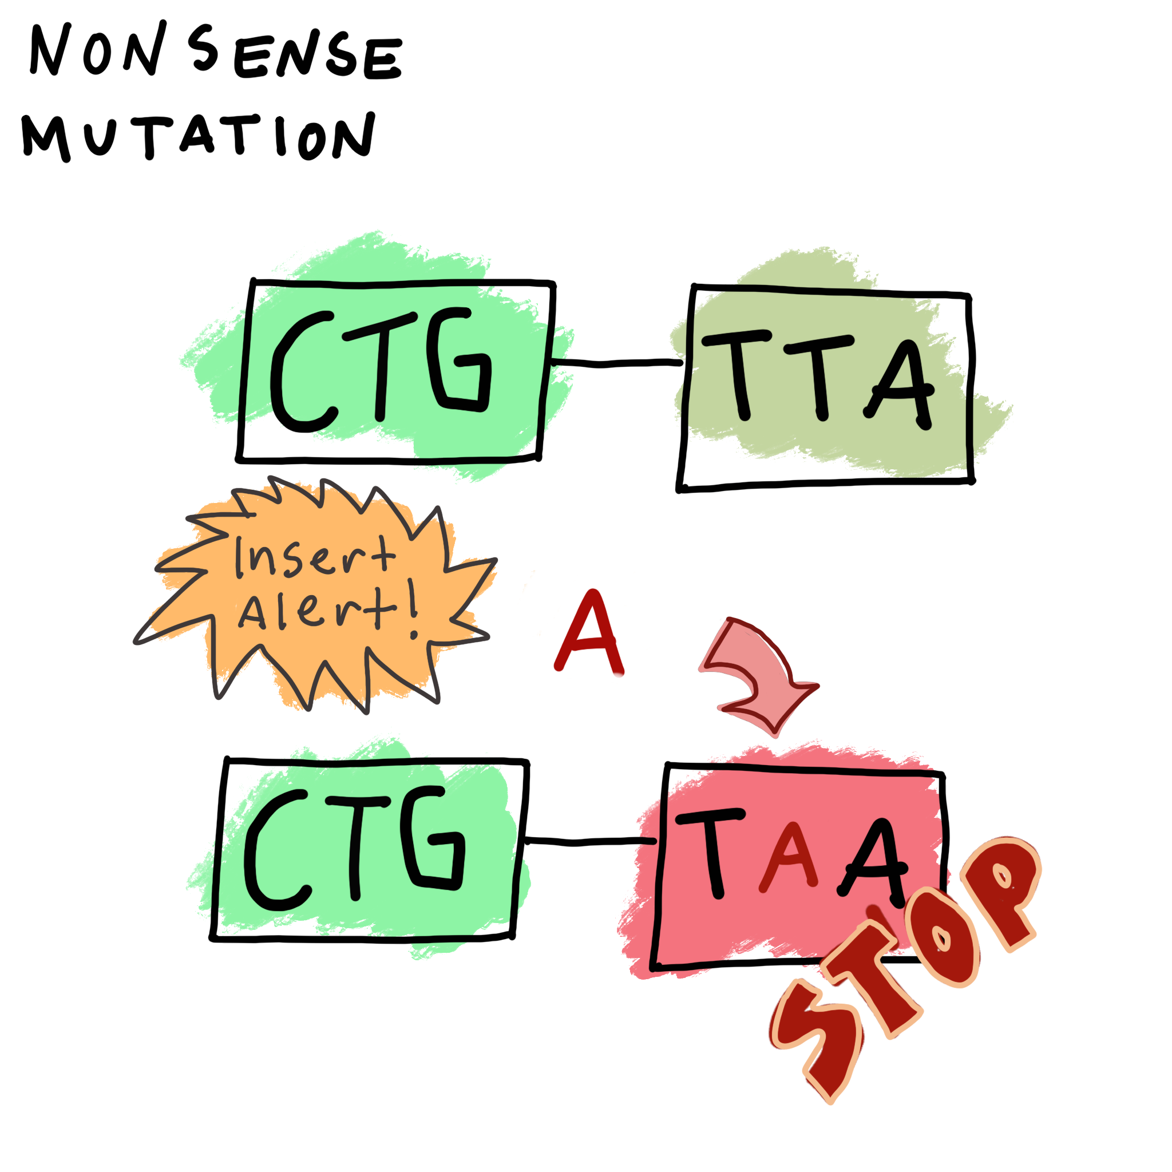
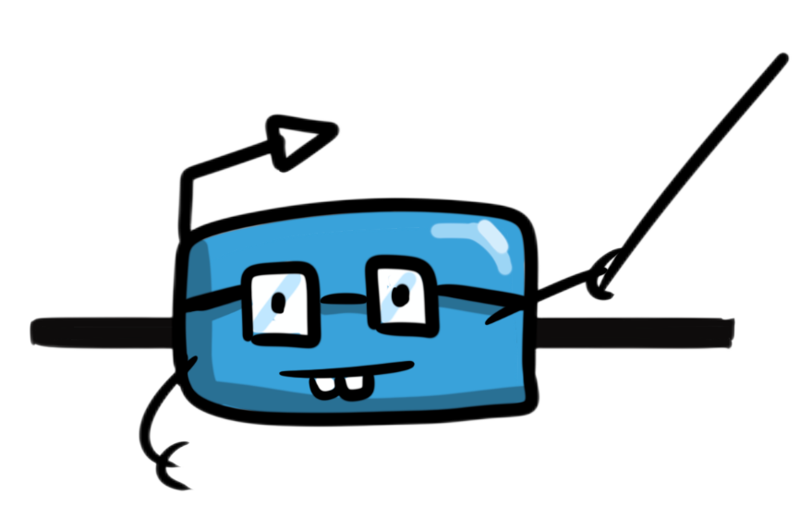
What are Nonsense Mutations and Frameshifts?
Notes:
The two main lesions (mutations that are cause complete non-function) that we are looking at are nonsense mutations and frameshifts. Both are major problems in translation for the bacteria. Nonsense mutations or stop mutations involve a change in the sequence that creates an early stop codon, causin a protein to terminate or translation to end earlier than expected. Another is a frameshift, which is a random insertion and deletion in the sequences that cause amino acids after the change to be mistranslated, creating the completely wrong protein or no protein at all. That bacteria is SOL.

Slide 5
Dead Gene Scanner.R
Use a curated database of reference genes
Blastn reference gene in whole genomes
Aim to find genes that missed annotation prediction
Find stop mutation in existing genes
Checks and reports for STOP point mutation or frameshift in results
Check 1000 genomes/min
Gene Lesion Type Lesion
adeS Frameshift I100fs
adeS Point Mutation Q204STOP
Blast match
and sequence extraction
Mutation
identification
Report
Table
Database
Notes:
One of software we developed is the Dead Gene Scanner R script. This script is a Blast wrapper that uses a curated database of known functional genes to look for whole or partial gene sequences in whole genomes files. Once the sequence is found it is extracted and screened for point mutation or frameshift. The script output a human readable table reporting the type of gene lesion and their position as well as other parameters. We parallelized the script which allows a quick screen of over a thousand genomes per minute.

Slide 6
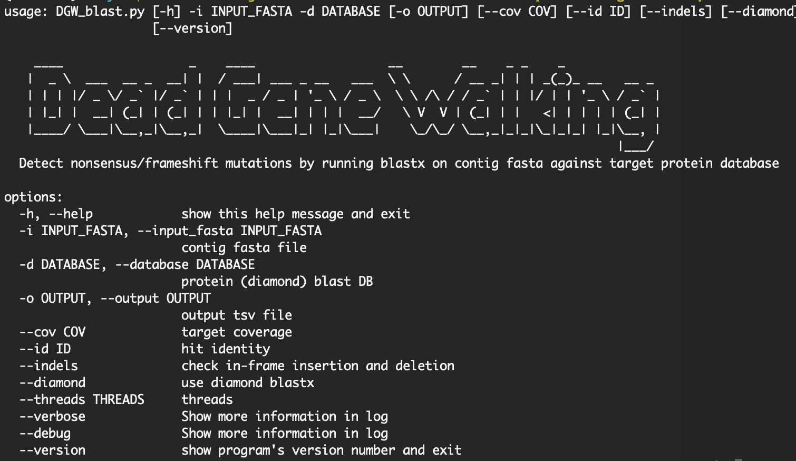
Technical approaches
Assembly sequence to identify broken genes
Translated alignment with BLASTX
Stop codon detection
A python script to run BLASTX and check the * position in the alignment.
Frameshift detection
“Diamond” blastx has option --frameshift to allow frameshift gap aligned and show / or \ in the alignment result
In-frame mutation is noted with - in the alignment. However, it is common and may not cause genes broken. (default detection is disabled.)
Notes:
If there is frameshift, NCBI blastx usually have two or more High Scoring Pairs (HSP) with high identity. Sometimes we can see “XXXX” in the protein alignment (“X” means unknown amino acid) but it won’t help us or at least no easy to detect the location.

Slide 7

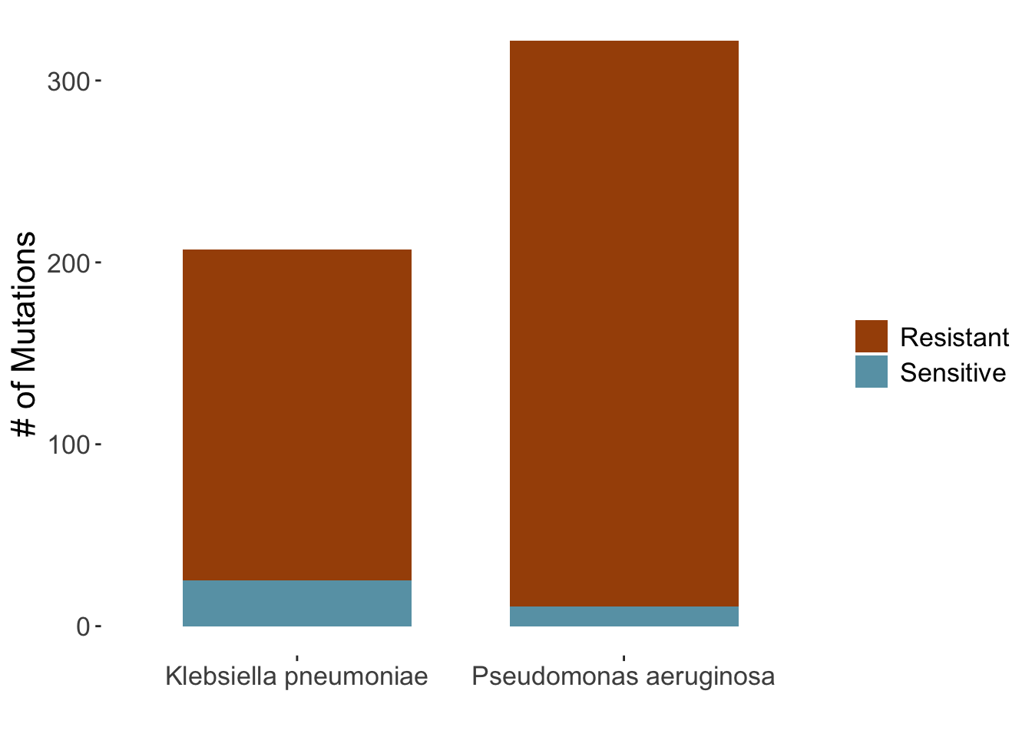
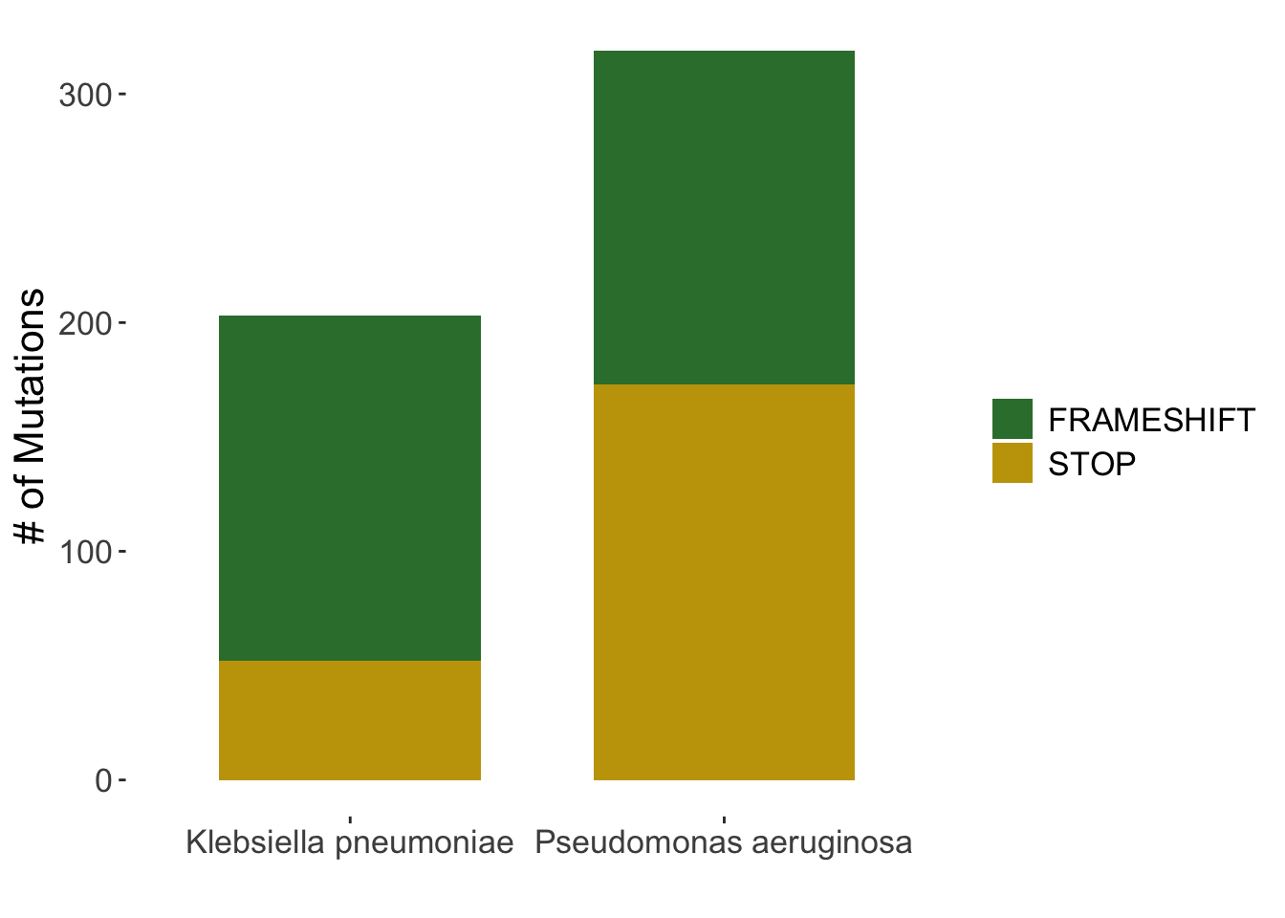
Test Analyses - AST testset
928 isolates
589 with resistant phenotype
493 mutations found
130 mutations were present in MicroBIGG-E too
363 new mutations in 353 isolates
339 with sensitive phenotype

Slide 8
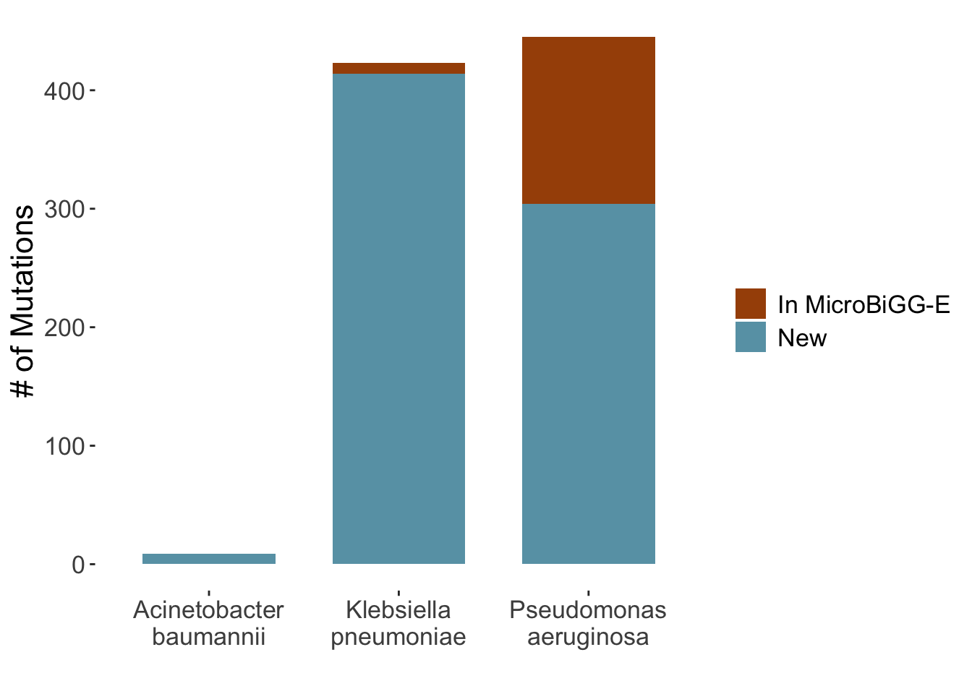
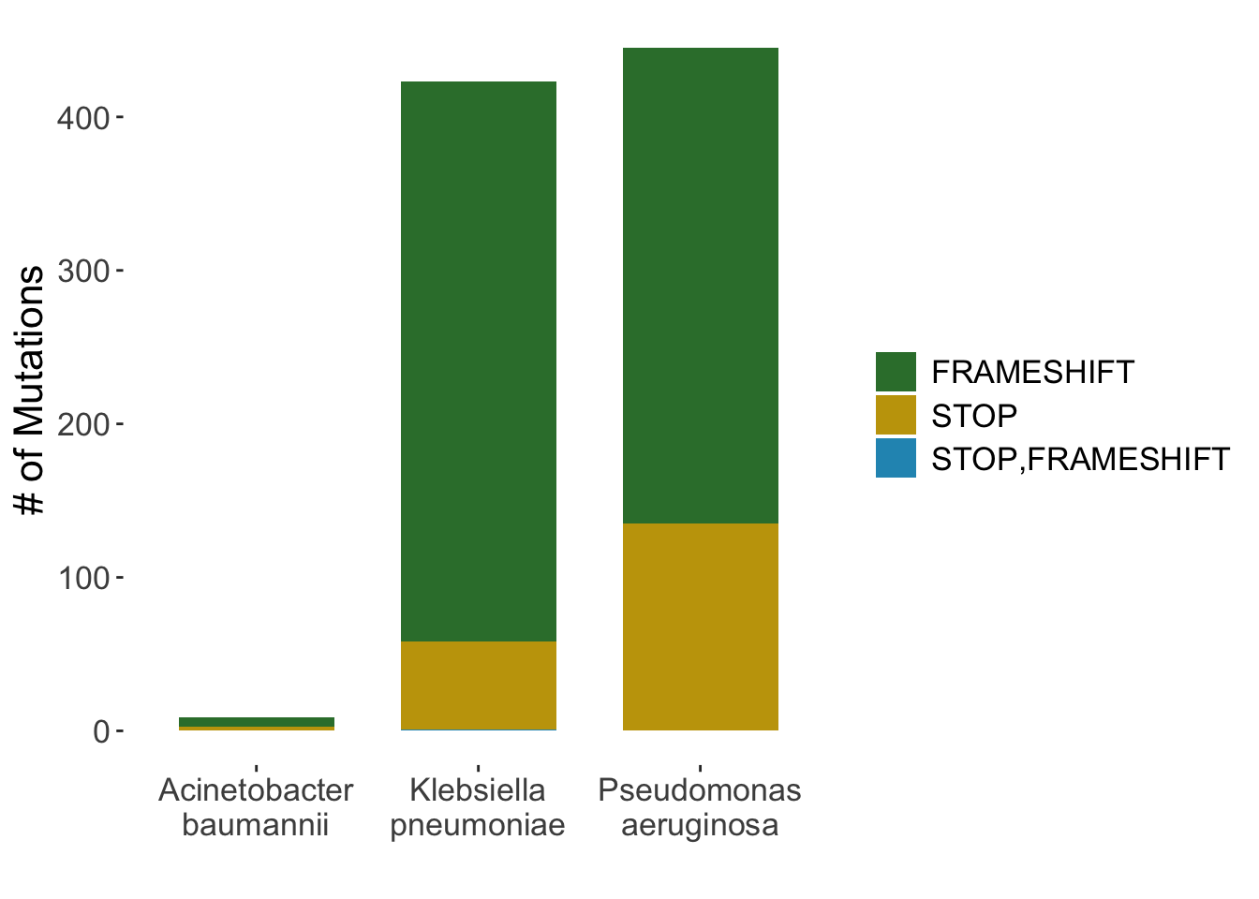
Test Analyses - Random testset
3000 isolates for Acinetobacter baumannii, Pseudomonas aeruginosa and Klebsiella pneumoniae
DGW identified 877 mutations
150 mutations were present in MicroBIGG-E too
727 new mutations in 353 isolates

Slide 9
Conclusions and Future Directions
We identified a novel OmpK35 frameshift mutation in isolate CP021955.1/SAMN04014948 which is highly carbapenem resistant and has no carbapenemases
Compare results from the two tools on a large set of assemblies
Run the tools on entire NDARO dataset to characterize frequency of these mutations
106,000 Klebsiella pneumonieae
39,000 Pseudomonas aeruginosa
36,000 Acinetobacter baumanii

